Slide 1
Architecture Proposal
Zhaolei
Notes:
我来应聘针对初创的技术架构
我最喜欢计算机技术。也喜欢商业，创业，也接触过很多孵化器和VC
能参与AWS的面试非常激动，因为AWS是我非常佩服的创新者，并且致力于客户的ROI
我一直使用AWS，从上家公司做CIO迁移业务系统，到现在创业基于AWS和阿里云OSS对象存储
AWS中国区的第一批用户，积极参与AWS线上线下的活动，ReInvent听Werner Vogels的演讲非常佩服，酒会不错
软件工程和自动化测试做的比较深，包括TDD、看板、CD、影响地图等：做手机游戏，一键打包8个版本。做ERP，只用3人的开发团队就可以迭代整个系统了。
我也想听听各位的职责，还有就个人而言，您想从今天的Presentation中获得什么信息
（记下反馈，在最后重提）

Slide 2
Assumptions of the customer
SaaS for Gas station management
Just got Pre A round funding from a traditional Gas equipment company
They are interesting in AWS Activate Plan
Low operation and maintenance capability. High Dev capacity.
Busy with JAVA Spring cloud microservices
Runing LAMP stack on the IBM server within the machine room of their parent company

Slide 3
Requirements & problems
Security
Security of data at rest and in transit
Self-healing infrastructure that recovers from failed service instances
Securing access to the environment as the delivery team expands
Disaster recovery
Cost
Efficiency: Scaling to meet the demand, but with uncertainty around when and how much this demand will be they are very concerned about buying too much infrastructure too soon or not enough too late
Archival strategy for inactive objects greater than 6 months
Performance
Ability to configure database and data access layer for high performance and throughput
Making the user experience in the browser very low latency even though a large portion of their user base will be from far away
Effective distribution of load
Ability to easily manage and replicate multiple environments based on their blueprint architecture

Slide 4
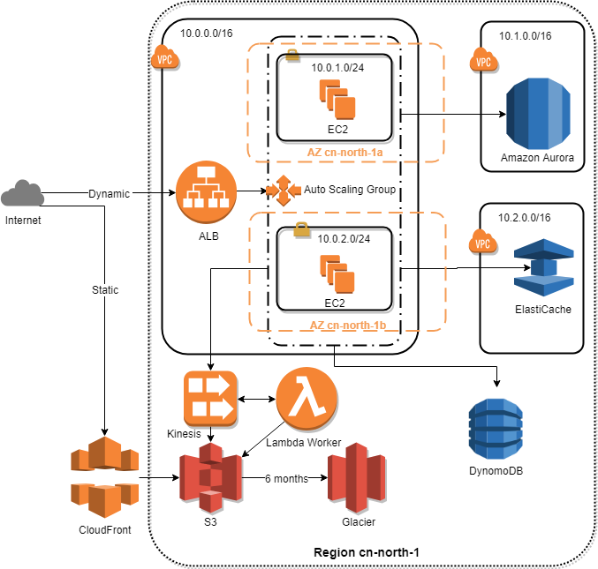
Architecture Proposal
Notes:
先大致看一下，逐个服务讲完后，我们会回过头来再整体看

Slide 5

Raise Goldfish, not sweat BMW
Notes:
不会因为伸缩性问题耽误了业务发展，或者因为初始成本太高浪费了宝贵的预算
性价比 Save money in the long run
CIO选型 金鱼而不是汗血宝马

Slide 6
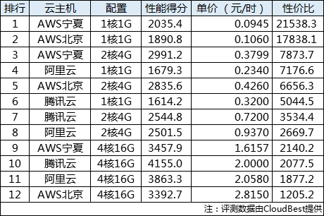
Reasonable price
http://cloud.idcquan.com/yjs/134551.shtml
Notes:
CIO价格选型的故事 横向扩展而不是向上扩展 一开始可以向上扩展，但是后来一定是横向扩展

Slide 7
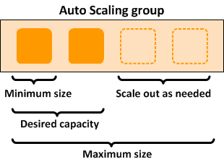
Save money in the long run by Auto Scaling
Notes:
不会因为伸缩性问题耽误了业务发展，或者因为初始成本太高浪费了宝贵的预算
半夜三点起来定位问题重启服务
核心理念 Save money
Easier for you to perform better
不同点：CloudWatch 命令行 CloudFormation
因为AWS有这个能力。几次创业都先用最便宜，最简单的机器。

Slide 8
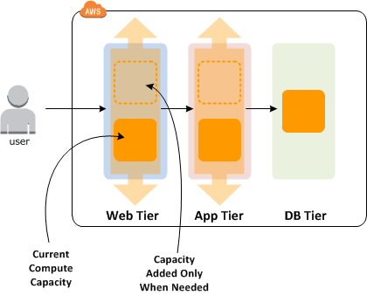
Save money in the long run at different tier
Notes:
甩手掌柜

Slide 9
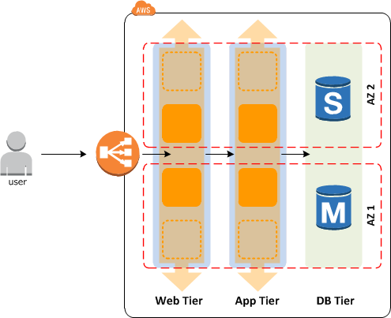
Disaster recovery by Availability zones
Availability zones — Two are used. If one availability zone (AZ) suffers from an outage, we still have EC2 instances running in the other AZ.
EC2 instances — We have multi-redundancy for EC2 instances. We have multiple instances in one subnet (AZ), and we have instances in two subnets (AZs).

Slide 10
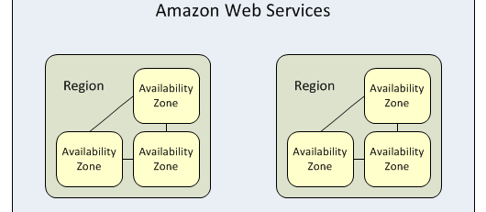
Don‘t put eggs in one basket – Region & Availability Zone
Notes:
万一机房出问题怎么办？万一云上也中断了呢？
Your strong support
Easier for you to perform better
北京，宁夏
鸡蛋不要放在一个篮子里

Slide 11
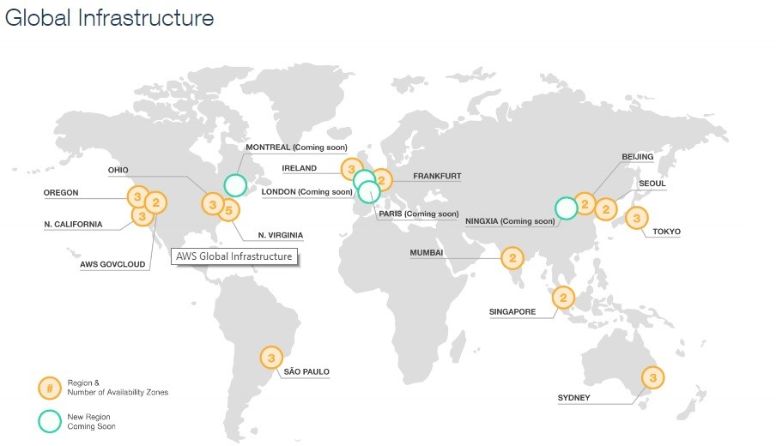
Notes:
Your strong support
Easier for you to perform better
全球客户触及

Slide 12













轻松管理
高度可扩展
可用且持久
快速
安全
便宜
Notes:
没有DBA，担心在业务上涨时，搞不定数据库的主从问题
总是手动备份数据，或者用cron没经过验证
备份 计费和使用简单
Save money：不需要DBA
Easier for you to perform better：安基ERP项目，依赖外部谈判。后来不再焦虑不懂数据库运营，轻松备份。

Slide 13
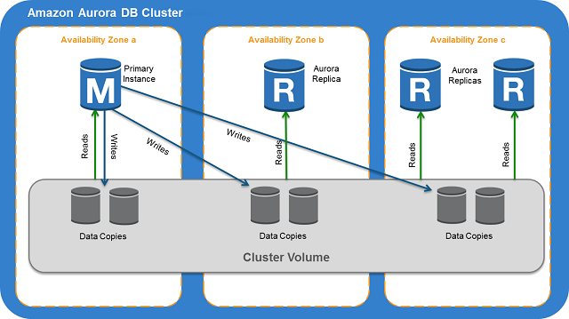
Notes:
没有DBA，担心在业务上涨时，搞不定数据库的主从问题
总是手动备份数据，或者用cron没经过验证
备份 计费和使用简单
Save money
Easier for you to perform better
安基ERP项目，不再焦虑不懂数据库运营，依赖外部谈判，轻松备份。
不需要DBA

Slide 14
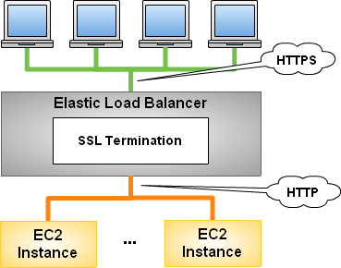
Security of data in transit using HTTPS
Notes:
CIO故事：不会配置HTTPS啊，学习又费时费力，哪有时间啊。事情太小找外包又不值得。但是用户又会在意数据传输的安全。
Easier for you to perform better
没有单台机的带宽限制

Slide 15
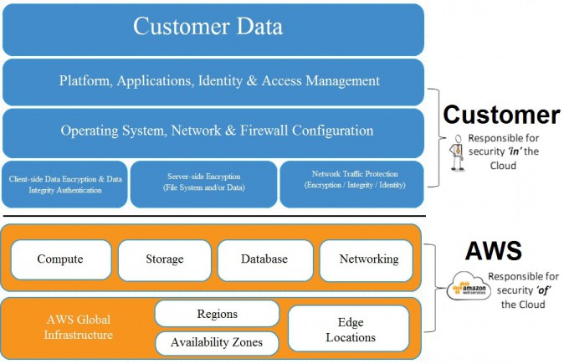
Amazon Web Services Security
Notes:
我的数据不会泄露给竞争对手吧？数据是我最重要的资产了。
自己的开发团队扩大了，不会有人把数据卖给竞争对手吧？
Your strong support
有名事件 vs 正直
不会被收集数据或者盗用

Slide 16
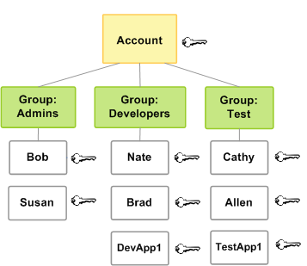
AWS Identity and Access Management (IAM)
Notes:
自己的开发团队扩大了，不会有人把数据卖给竞争对手吧？
身份及访问管理
Securing access to the environment as the delivery team expands
CIO自己针对团队给予不同的组权限，不需要网管

Slide 17
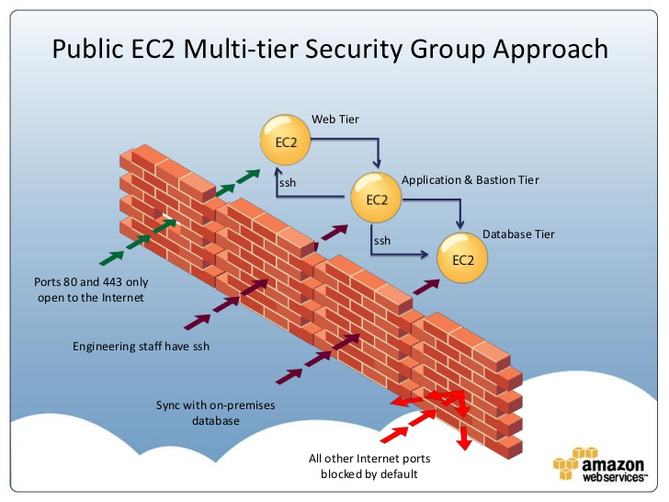
Protect your network with security groups
Network administrators are no longer needed
Notes:
数据不会被黑客盗取吧？
安全组（防火墙），只开放最少的端口给最小的范围

Slide 18
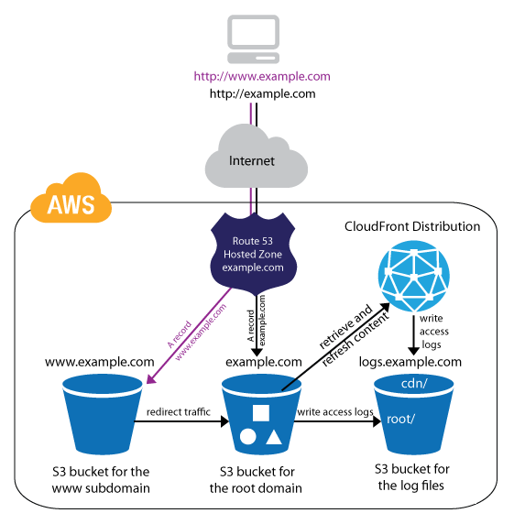
Use S3 & CloudFront to deliver the static web content
Notes:
用户体验是非常重要的，如果主页就要加载10秒钟，我的面子往哪儿搁？
Easier for you to perform better: 功能强大 metadata 自动化。
创业-自动化上线, SDK vs cli

Slide 19
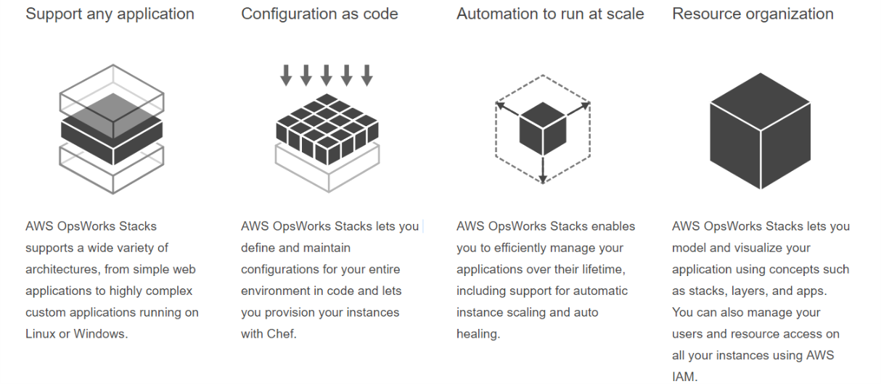
OpsWorks Stacks
Easily manage and replicate multiple environments based on your blueprint architecture
Notes:
微服务之后，会不会搭一个测试环境就好几天，还是干脆多花点钱一直保留几个环境？
Easier for you to perform better：友商在学习。图形化自动化运维应用。第一次用，惊叹，非常好用。

Slide 20
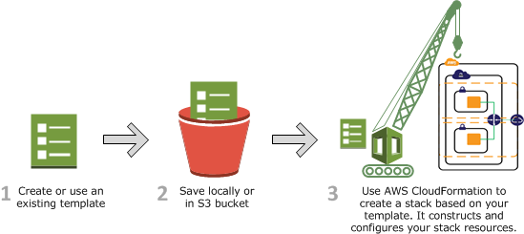
Easily manage and replicate multiple environments based on your blueprint architecture by CloudFormation
Notes:
微服务之后，会不会搭一个测试环境就好几天，还是干脆多花点钱一直保留几个环境？
Easier for you to perform better
友商在学
强大的自动化运维应用
第一次用，复杂，全面覆盖

Slide 21
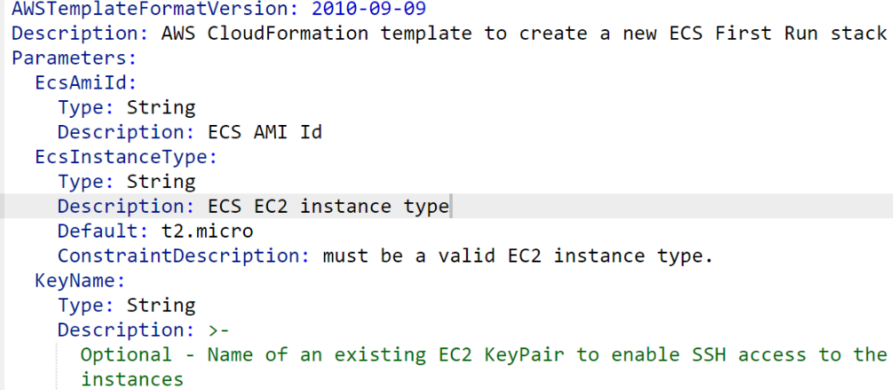
Easily manage and replicate multiple environments based on your blueprint architecture by CloudFormation

Slide 22
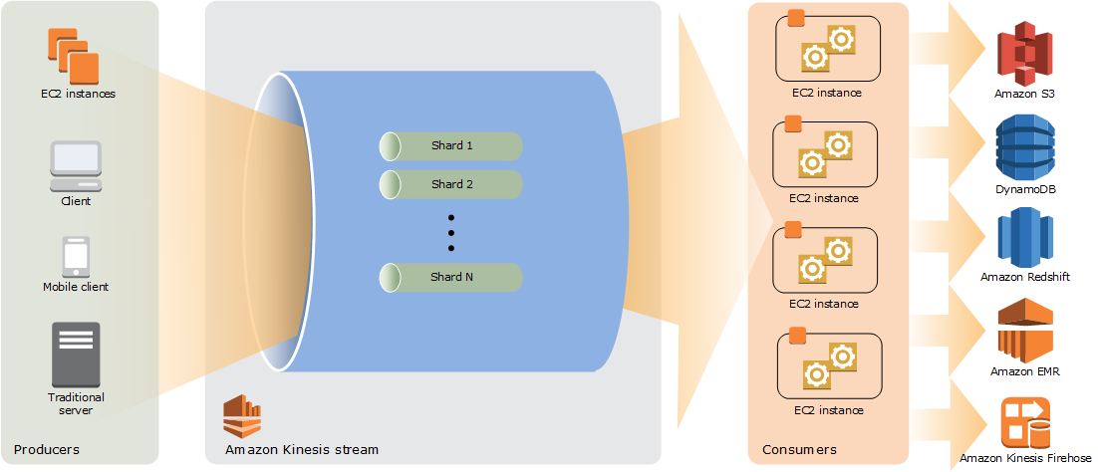
Effective distribution of load asynchronously by Kinesis
Notes:
有些实时性要求不强的场景，也需要我搞那么强大的服务器吗？
Kinesis
Easier for you to perform better自己开发的
第一次用非常简单 vs kafka非常麻烦Zookeeper，需要太多决策：对手标准Kafka在内测，不好控制

Slide 23
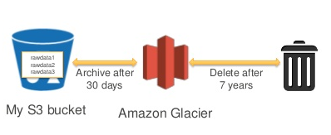
Data stored in S3 can be configured by a lifecycle rule to move objects to Glacier automatically
Notes:
云上的存储会不会太贵？自己买硬盘也很便宜啊。
后付费vs预付费
S3, Glacier便宜
Easier for you to perform better
Save money in the long run
故事：这么简单，还想自己买存储吗？
不需要存水，自来水

Slide 24
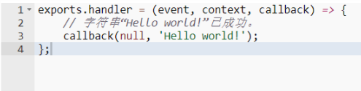
Serverless by lambda
Notes:
快速试验新想法的时候，还要申请资源，搭环境，配框架和数据库？还要考虑扩展性？
Serverless的发明者
结合 SAM
Easier for you to perform better

Slide 25


ElastiCache
DynamoDB
A in-memory database Compatible with redis and memcached
A key-value store with document support (NoSQL).
Notes:
无状态X Scaling
ElastiCache部署简单Easier for you to perform better 不折腾
NoSQL
DynamoDB。即开即用，高可用，不用担心服务器问题。Easier for you to perform better
故事：事件记录。

Slide 26
Just remember that AWS Help you
Save money in the long run
Easier to perform better
Your strong support

Slide 27
Q&A

